Slide 1
Games Development Project
Leon Irving B00301496

Slide 2
Overview
- ‘Interloper’
- A sci fi single player first person shooter
- Player fights enemies, picks up weapons etc., completes objectives
- Inspired by games such as Halo, Doom, Destiny etc.

Slide 3
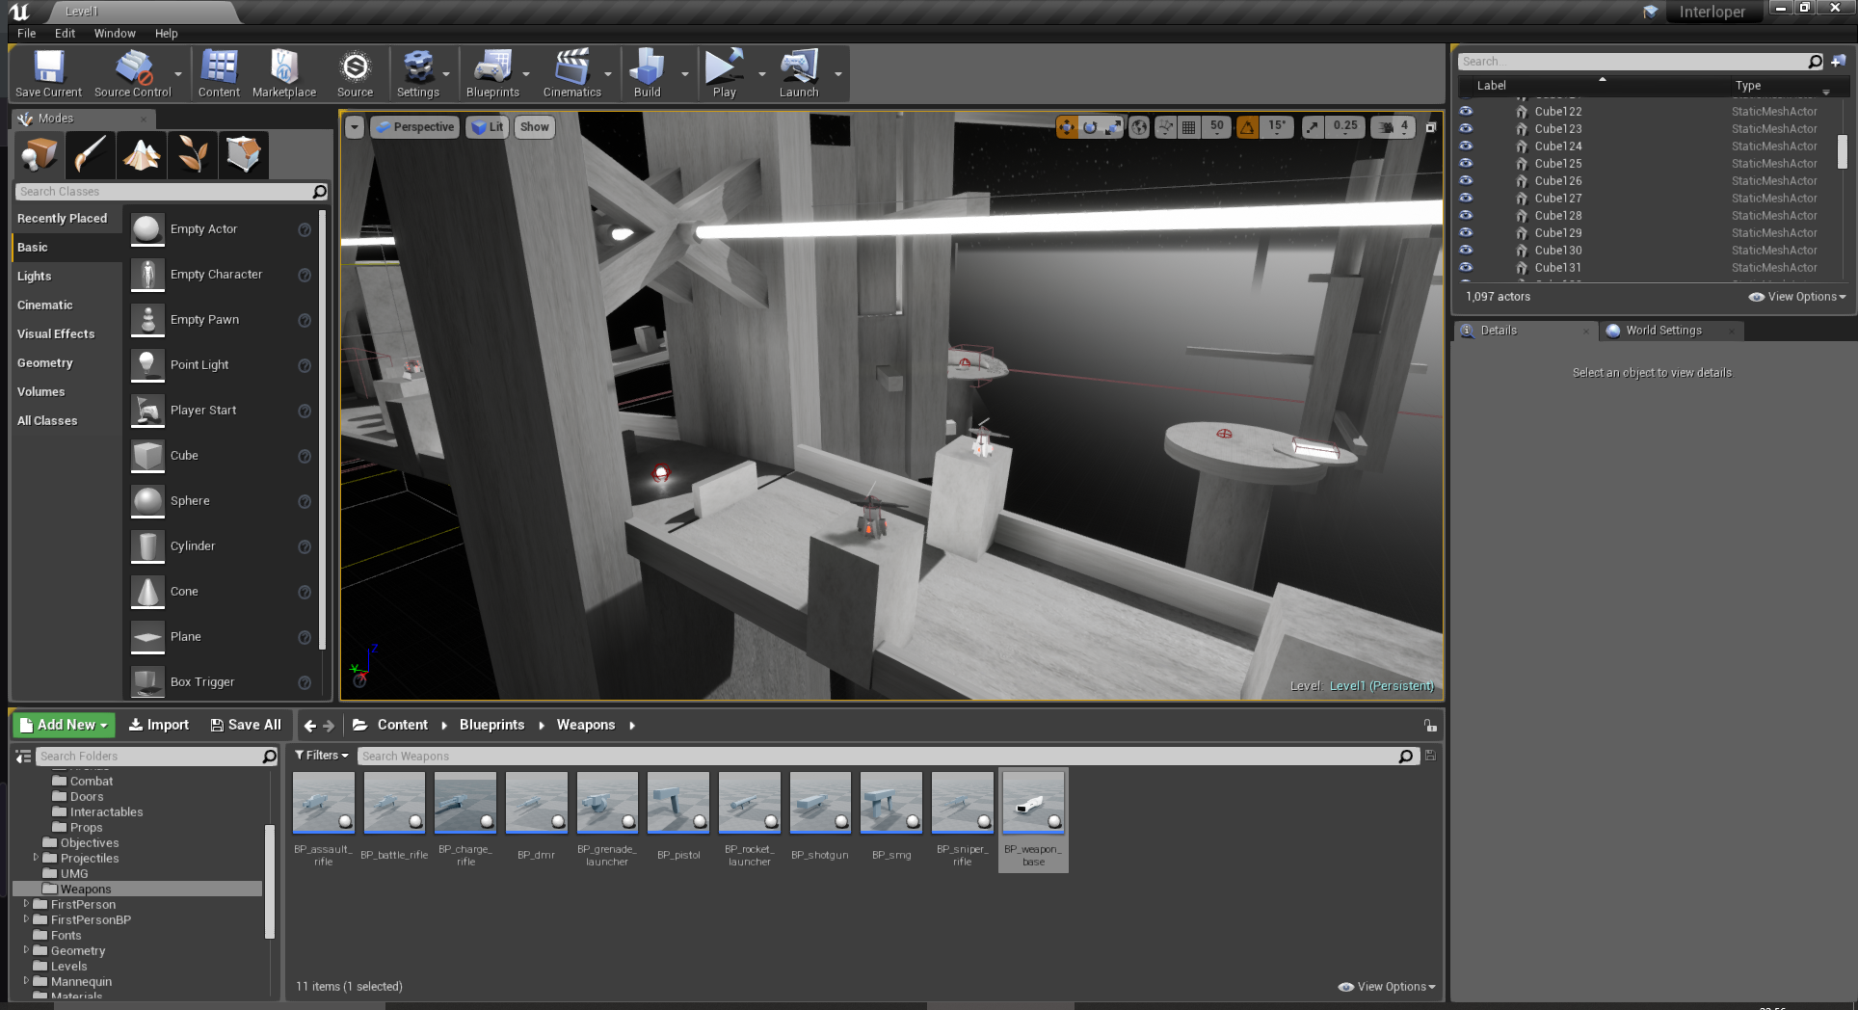
Game Engine
Unreal Engine 4
- Prior development experience
- High support for first person games
- Easy implementation of high fidelity lighting
and graphics

Slide 4
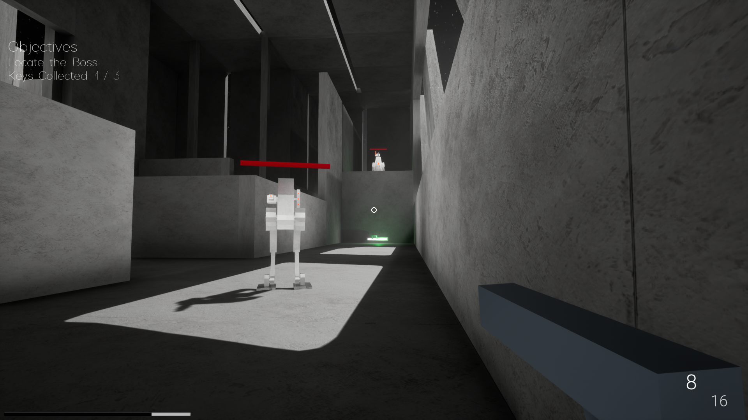
Gameplay and Mechanics
- First person shooting and controls
- Multiple different weapons
- Variety of enemies
- Boss battles
- Objectives
- Interactable objects

Slide 5
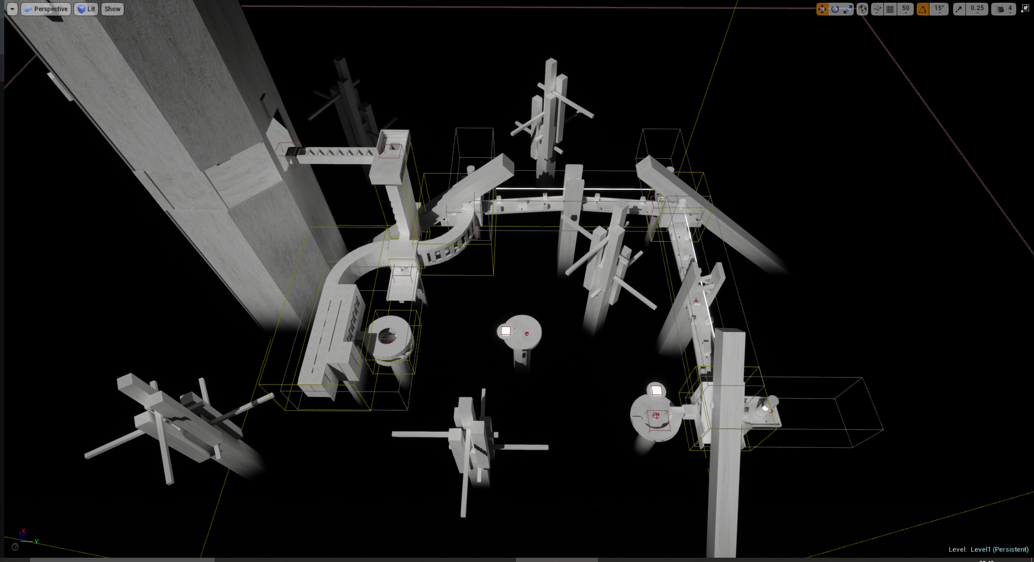
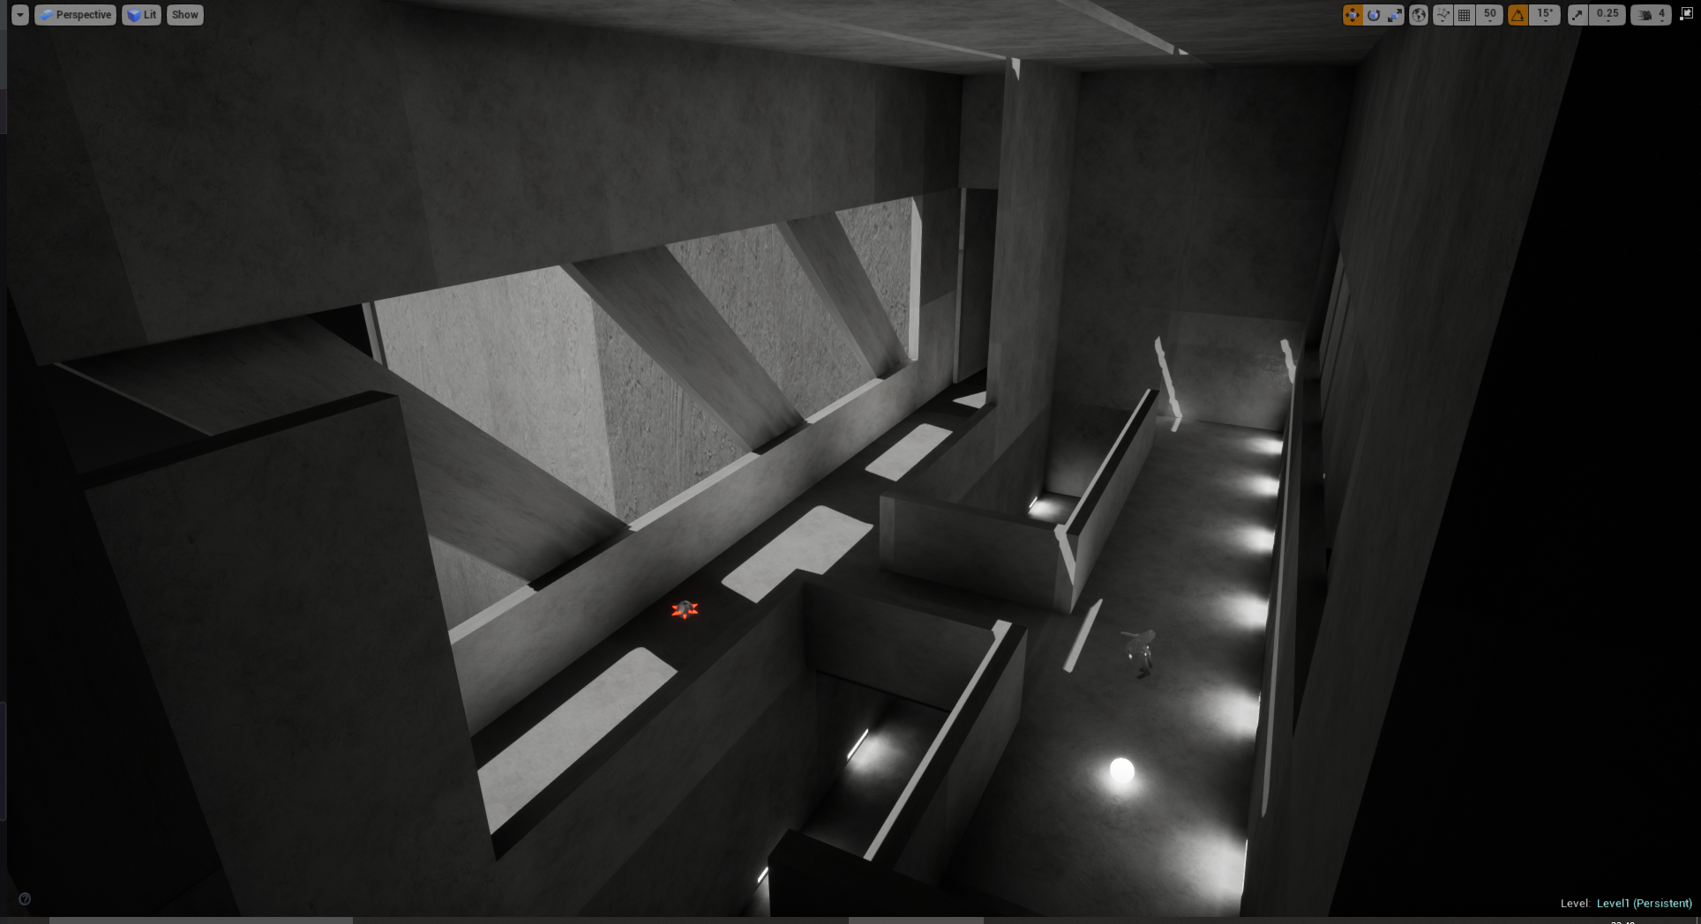
Level Design
- Begins in Hub area; doors to each level
- Multiple paths
- Ends with boss battle
- Abstract, minimalist art style

Slide 6
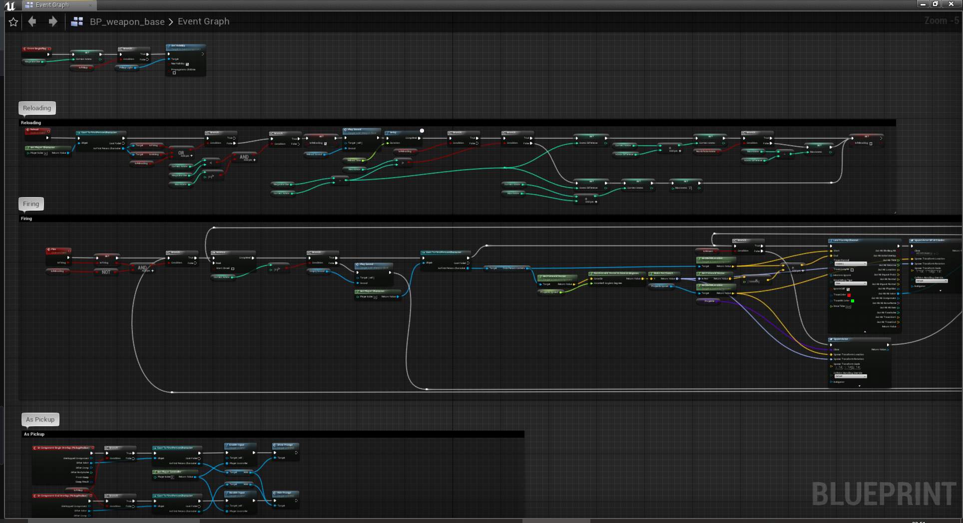
Implementation
- UE4 Blueprint visual scripting
- Allows rapid prototyping
- Photoshop for UI and Texturing
- Blender for 3D models

Slide 7
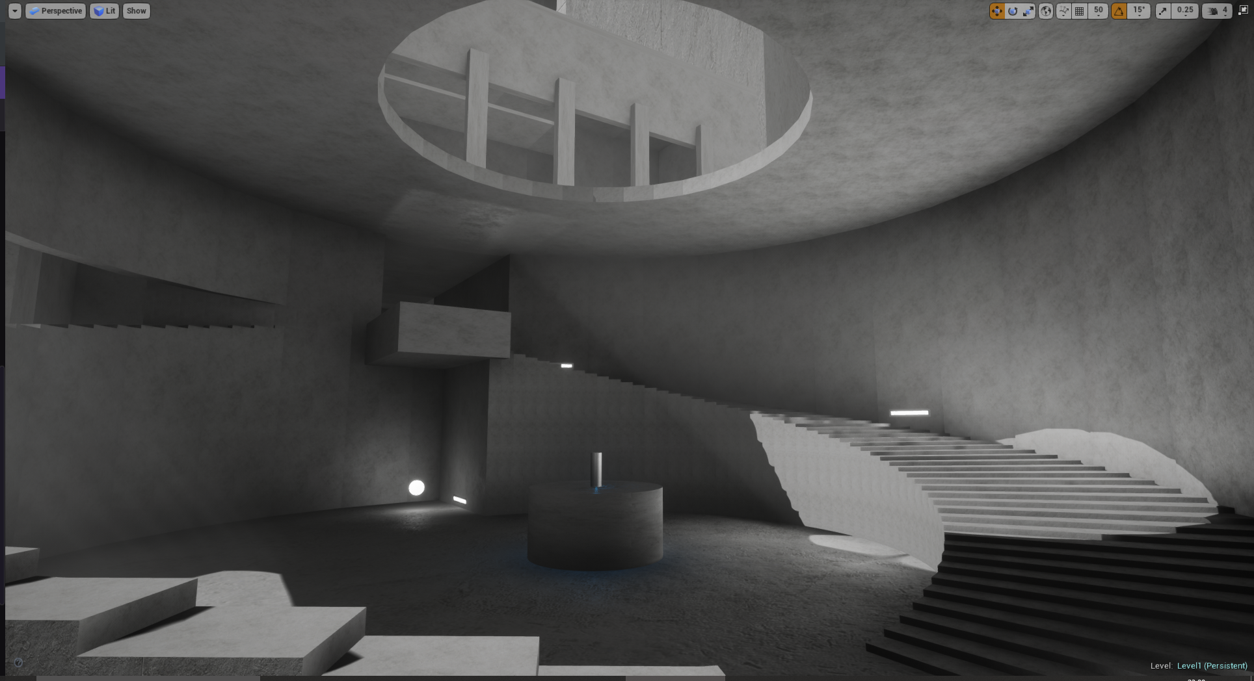
Immersion
- Audio
- Lighting
- Game atmosphere
- Environment design

Slide 8
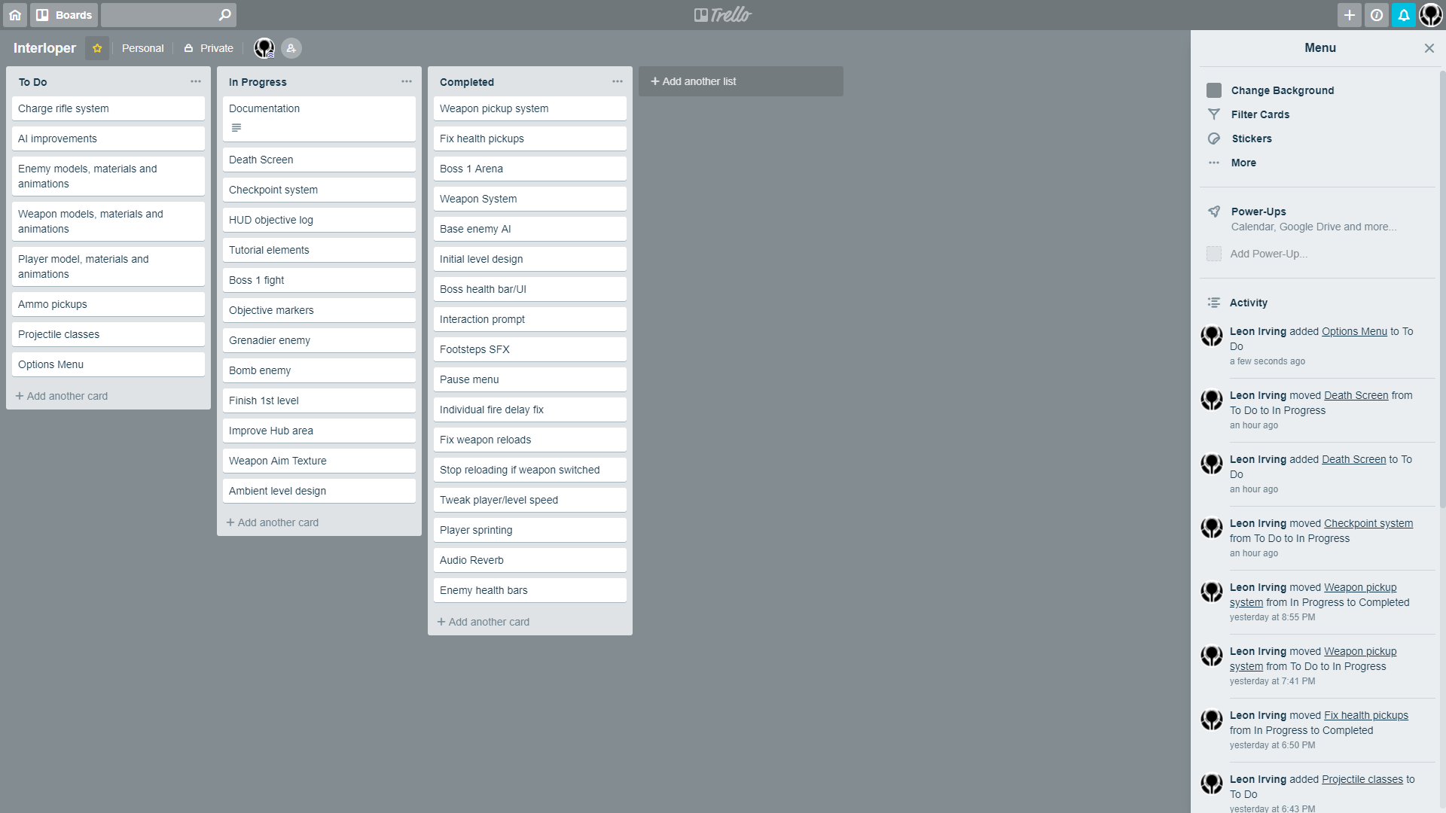
Project Management
- Trello
- Google Drive
- Git Integration

Slide 9
Learning Experience
- Class based implementation
- More complex mechanics
- Blueprint scripting
- Level design
- Project planning and management

Slide 10
Prototype Demo
Demo Playthrough: https://www.youtube.com/watch?v=GDxmq_6-c6I
Demo Commentary: https://www.youtube.com/watch?v=lVygaU1yAS4

